Slide 1
Electric Keyboard Arduino project
Embedded Systems – hardware ica
Karolin Hannan
Peter Mcteague
Adam Mitchell

Slide 2
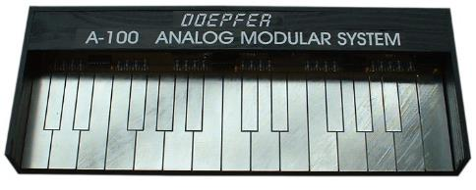
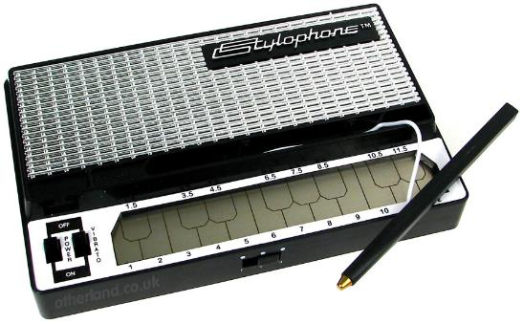
Project concept
The idea of the application was to build a musical instrument using the components included in the Arduino kit. The major feature of this instrument is that the output note is selected by touching a stylus against a piano-like keyboard.
Initially the idea was that when the stylus makes contact with a key, a resistor is selected that corresponds to the required note, however the resistors with the exact values required for this were not readily available.

Slide 3
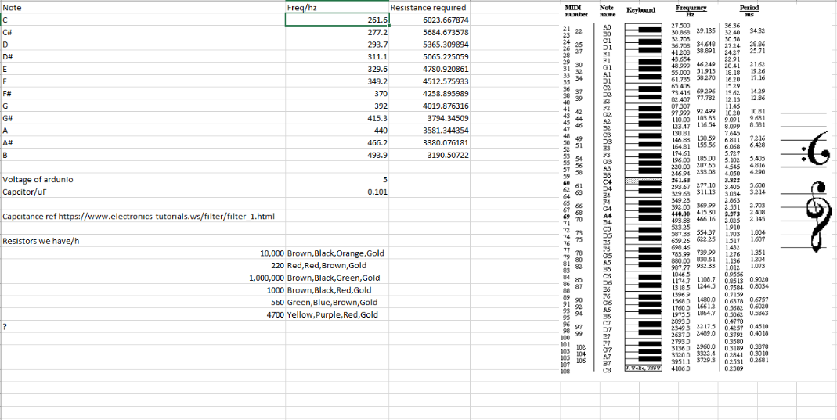
Resistors & their frequencies

Slide 4
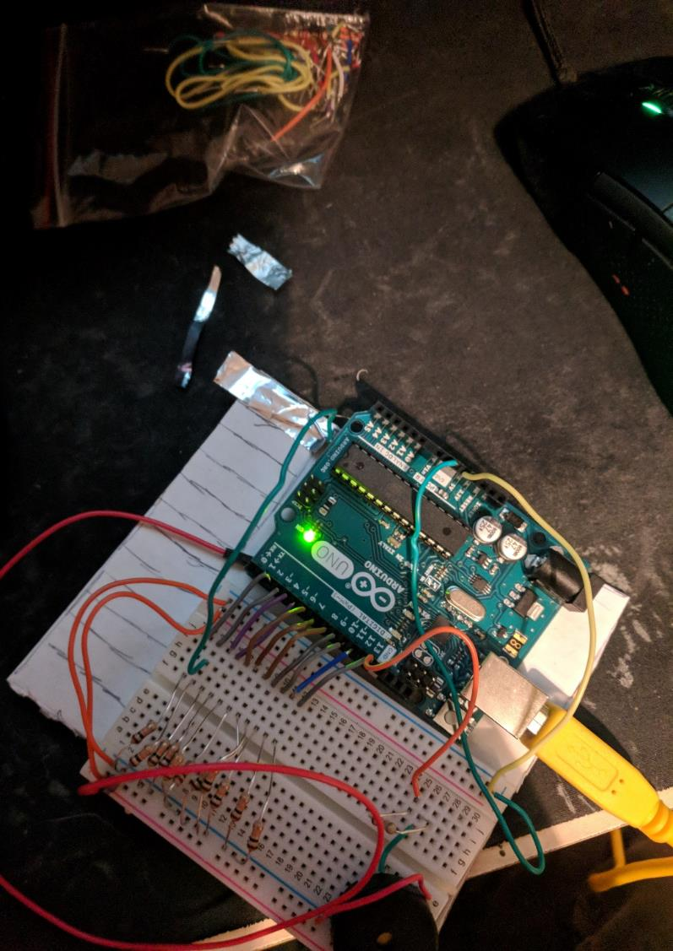
Initial Requirements
1 x Arduino UNO
1 x Arduino breadboard
Assorted Wires
11 x resistors
1 x stylus wire
1 x PIEZO buzzer
1 x USB cable
Conductive material (For keys)

Slide 5
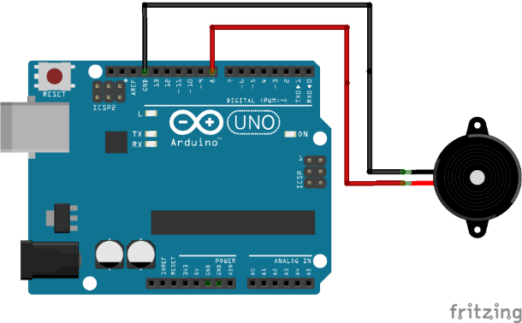
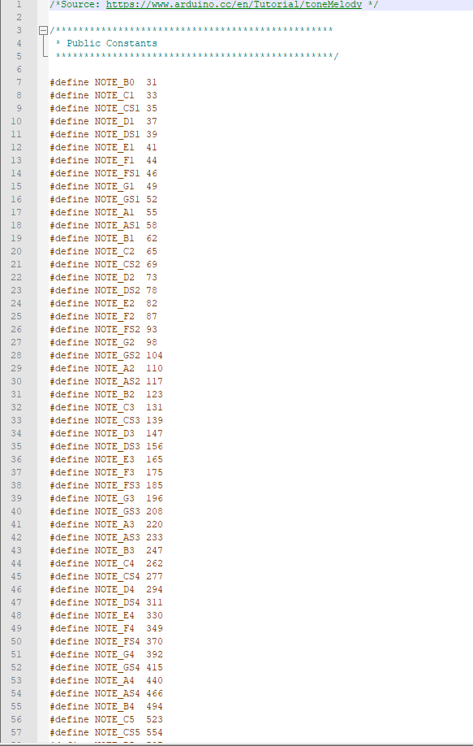
1. Testing the buzzer
How to use buzzer tutorial with tone file [1]

Slide 6
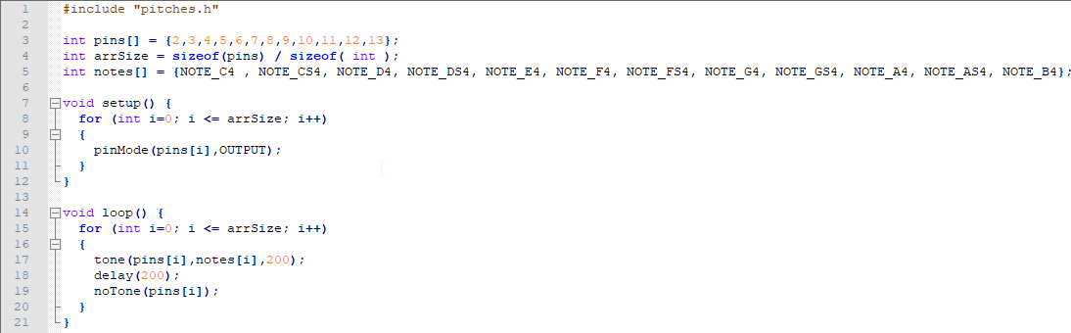
2. Simple output
Digital outputs
Single tone

Slide 7
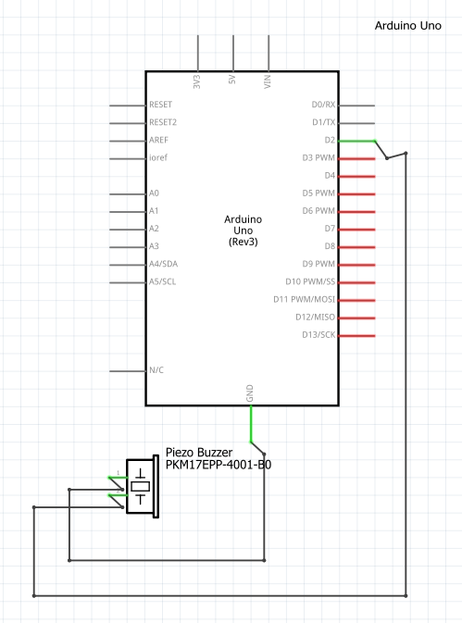
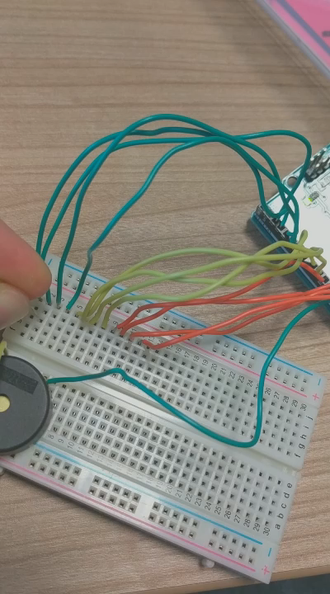

Slide 8
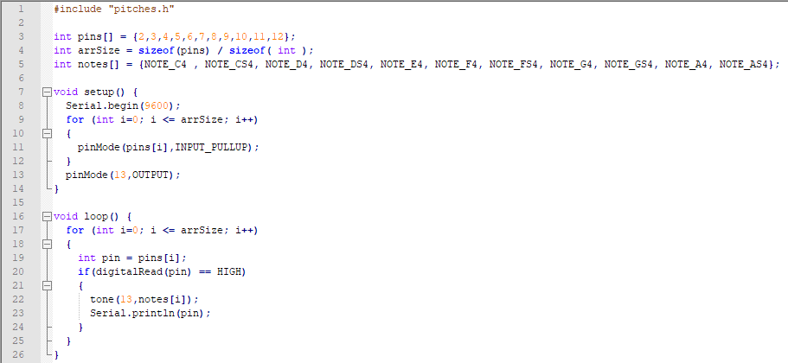
3. Multiple note output
If HIGH

Slide 9
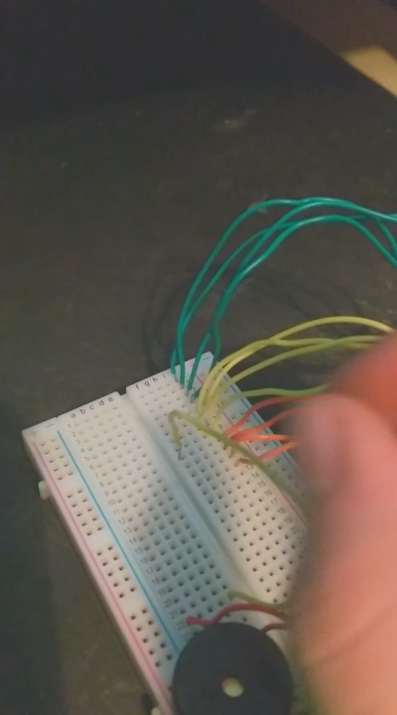

Slide 10
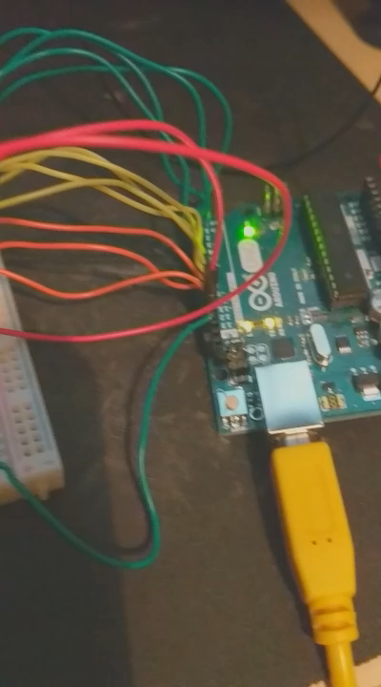
4. Selecting pins for keys
Didn’t previously have any way to support pressing keys.
Added wire and used previous wires for input
Noise

Slide 11
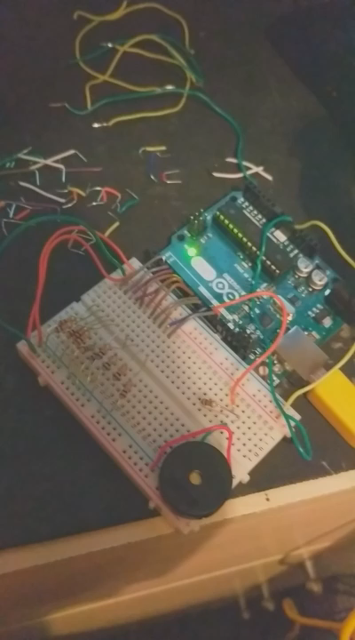
5. Fixing the noise
Caused by the environment – fixed by pull-up resistors
Electric changes

Slide 12
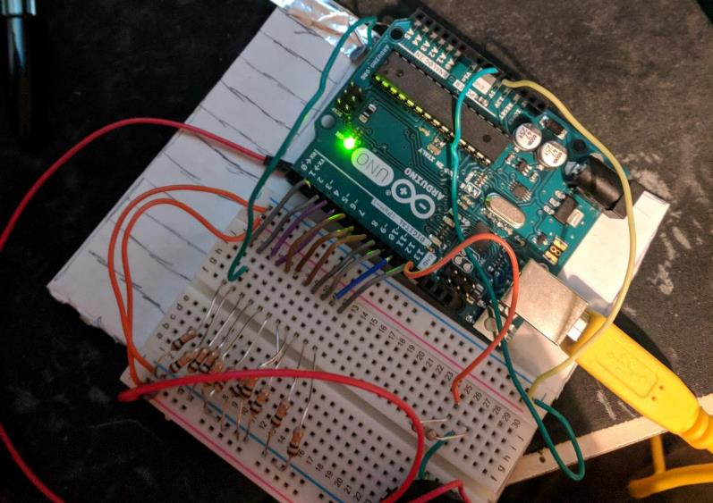
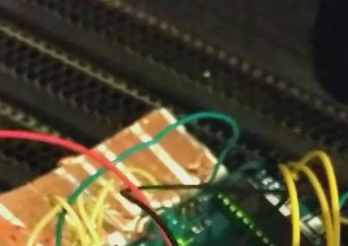
6. Keys
Surface
Tin foil keys
Copper tape keys

Slide 13
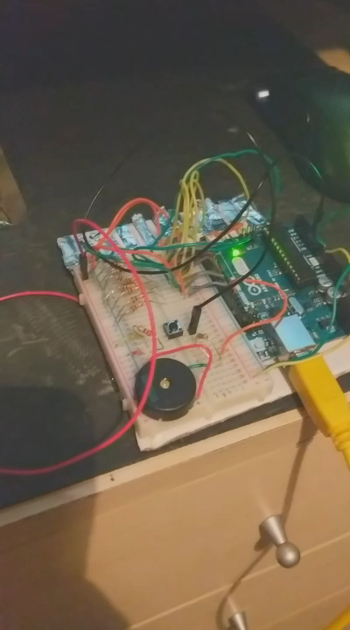
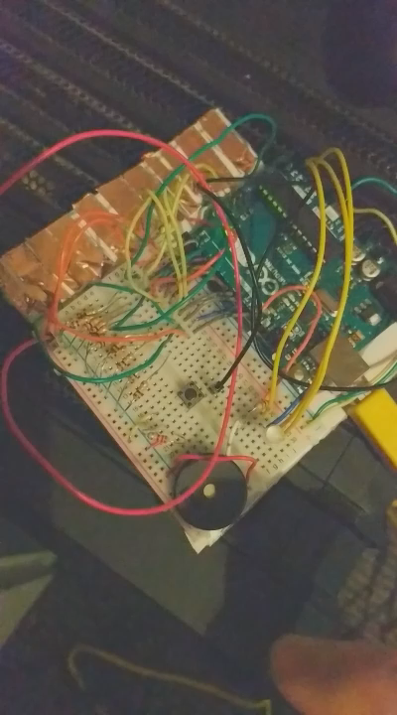
7. Buttons and Lights
Why?
What do they do?
How?

Slide 14
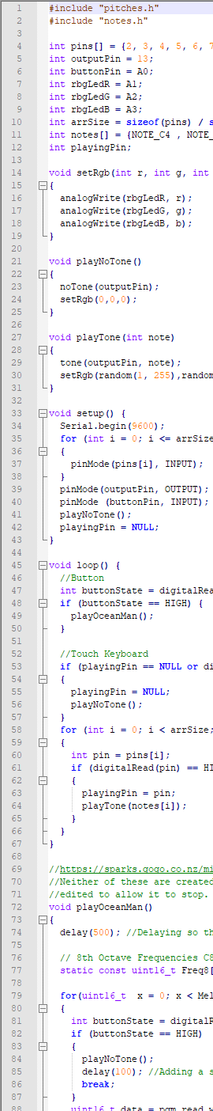
Midi to Arduino code generator [2]
Ween – Ocean Man , Midi file [3]

Slide 15
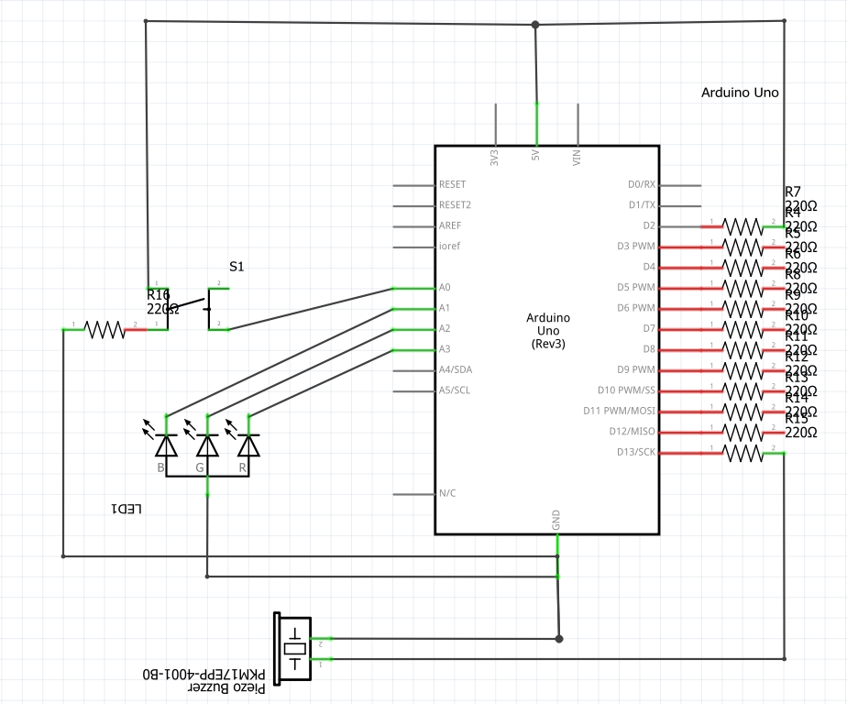

Slide 16

Evaluation of the prototype
There are many benefits of using Arduino to build a prototype. [4][5]
Goals achieved and more.
For future marketing, improvements would be made. When it’s time to convert the prototype into a real product, a custom system would be used for lower cost, smaller physical size, and lower power consumption. It would also have components shielded and the stylus-wire would be swapped out for a more professional looking instrument.
Software for song upload.
Would market towards kids and hobbyists.

Slide 17
References
Arduino.cc. (2018). Arduino - PlayMelody. [online] Available at: https://www.arduino.cc/en/Tutorial/PlayMelody [Accessed 10 May 2018].
Sparks.gogo.co.nz. (2018). Create Tone Player from Midi. [online] Available at: https://sparks.gogo.co.nz/midi_tone.html [Accessed 10 May 2018].
Online Sequencer. (2018). Ween - Ocean Man (WIP) (#398655). [online] Available at: https://onlinesequencer.net/398655 [Accessed 10 May 2018].
Amad, T. (2017). Arduino, What is It Good For?. [online] Element 14 Community. Available at: https://www.element14.com/community/docs/DOC-86369/l/arduino-what-is-it-good-for [Accessed 11 Apr. 2018]
Sarwar, I. (2016). Advantages and Disadvantages of Using Arduino | Engineer Experiences. [online] Engineer Experiences. Available at: http://engineerexperiences.com/advantages-and-disadvatages.html [Accessed 13 Apr. 2018]

